Slide 1
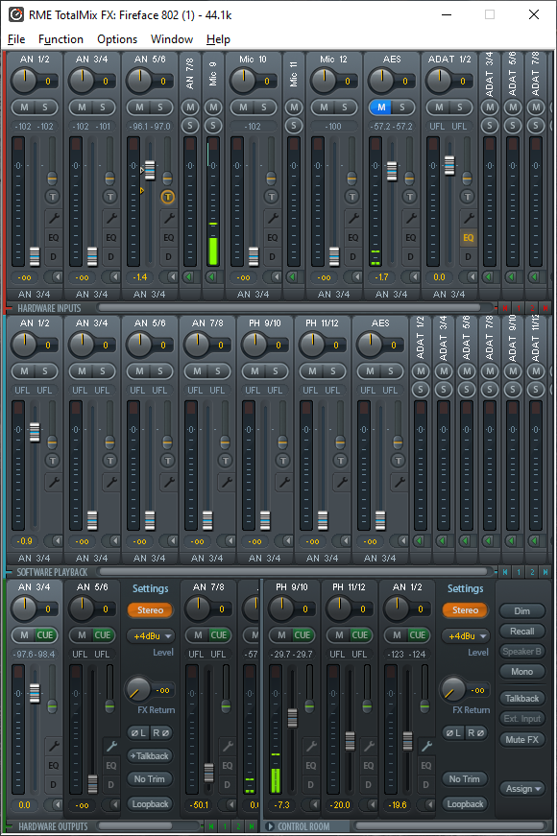
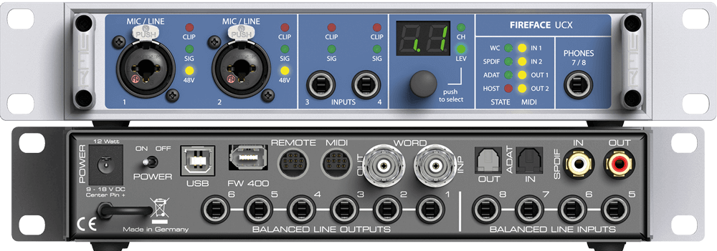
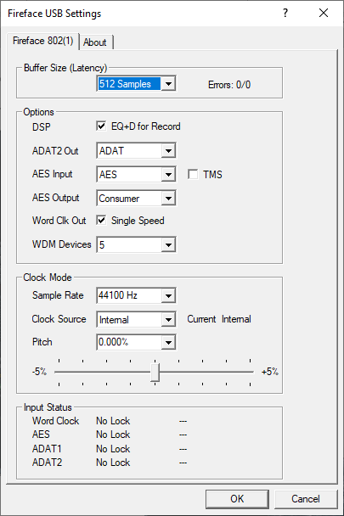
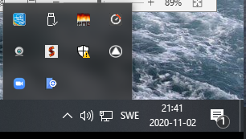
The parts
"TotalMix" control software
Hardware
Hardware config panel
Windows icon tray

Slide 2
The 18 hardware inputs
ADAT 11-18
optical link, 8 channels
SPDIF 9-10
digital, stereo
8
2
AN 1
Mic/Line 1
AN 2
Mic/Line 2
AN 3 AN 4
Line inputs
AN 8 AN 7 AN 6 AN 5
More ANalog line inputs
XLR connector: mic with pre-amp
(Phantom pwer is enabled in TotalMix)
Jack plug: line
(In SuperCollider and FonaDyn, these are numbered 0…17.)

Slide 3
The 18 hardware outputs
AN 7-8
analog, stereo
headphones or line output
2
ADAT 11-18
optical link, 8 channels
8
SPDIF 9-10
digital, stereo
8
2
AN 6 AN 5 AN 4 AN 3 AN 2 AN 1
ANalog line outputs
(In SuperCollider and FonaDyn, these are numbered 0…17.)

Slide 4
Signal flow
All computer apps
with record and/or play
Choose record device in the app
Choose playback device in the app
18 fixed gain
Hardware inputs
(18 sliders top row)
Software playback
(18 sliders middle row)
Each output gets its own mix of up to 18+18 inputs
Hardware outputs
(18 sliders bottom row)

Slide 5
TotalMix signal flow
Hardware inputs
Audio software apps
Record Play
top row
middle row
HARDWARE INPUTS
SOFTWARE PLAYBACK
mixing
bottom row
HARDWARE OUTPUTS
Hardware outputs

Slide 6
From the UCX manual
record
record

